Slide 1
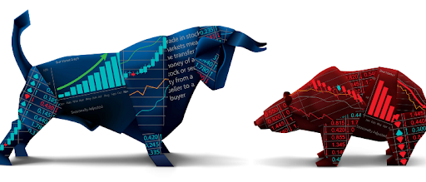
Final Project Presentation
Market Regime Detector
Team Members:
Asi Sheratzki
Emanuel Berdugo
Roy Toledano
Yonatan Mirsky
Mentor:
Morris Alper

Slide 2
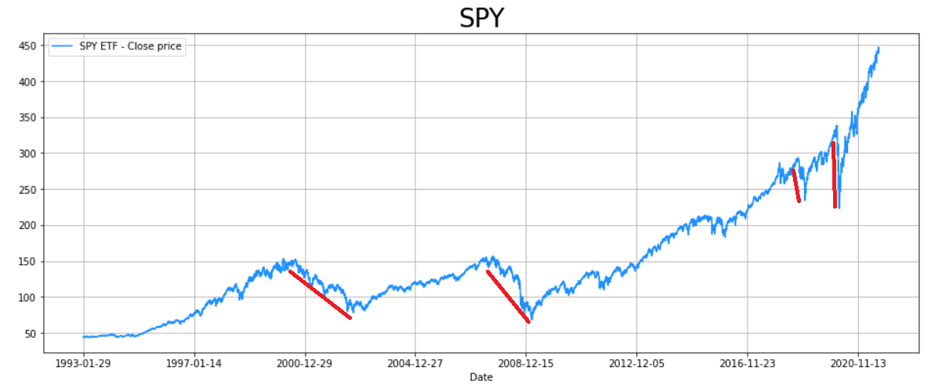
Project Goals
The main objective of the project is to design a Trading Strategy that can beat the Market!
Our model goal is predicting when we need to go out from the market and not to invest.
If we can predict when the
market is down we can take
the money out and wait
before investing again.

Slide 3
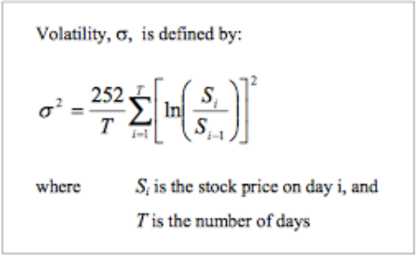
Terminology
Volatility - Volatility is a statistical measure of the dispersion of returns for a given security or market index.
Return - A rate of return (RoR) is the net gain or loss of an investment over a specified time period, expressed as a percentage of the investment’s initial cost.

Slide 4
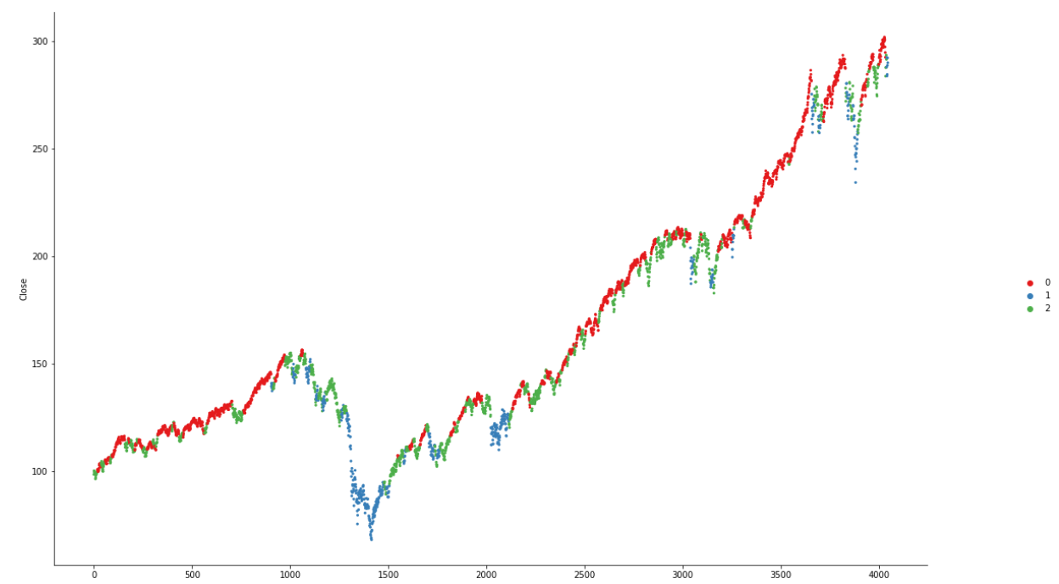
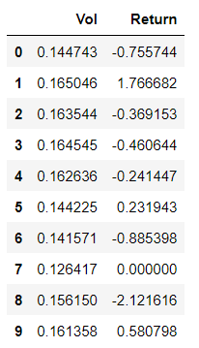
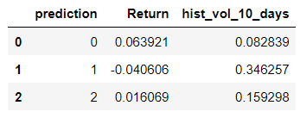
Model, input and output
INPUT
OUTPUT

Slide 5
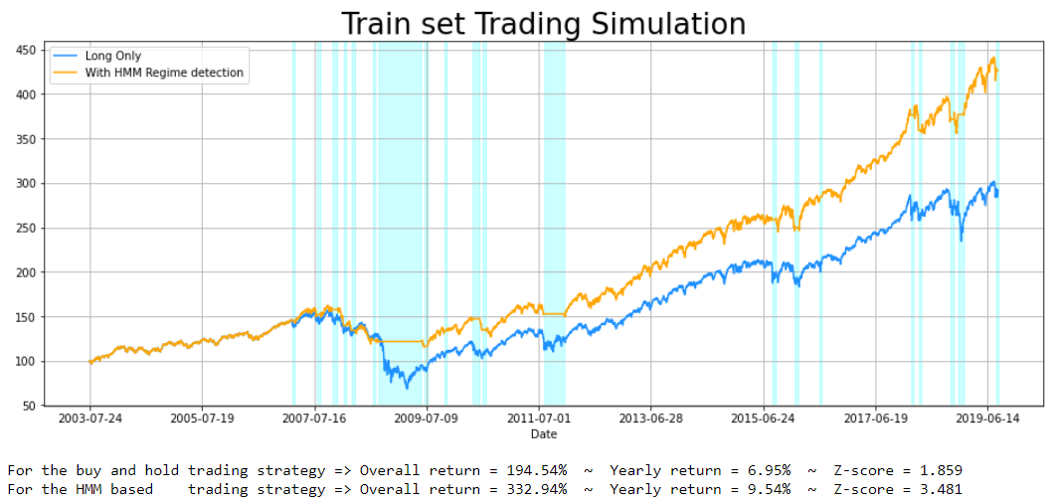
Predictions – Train And Test Sets

Slide 6
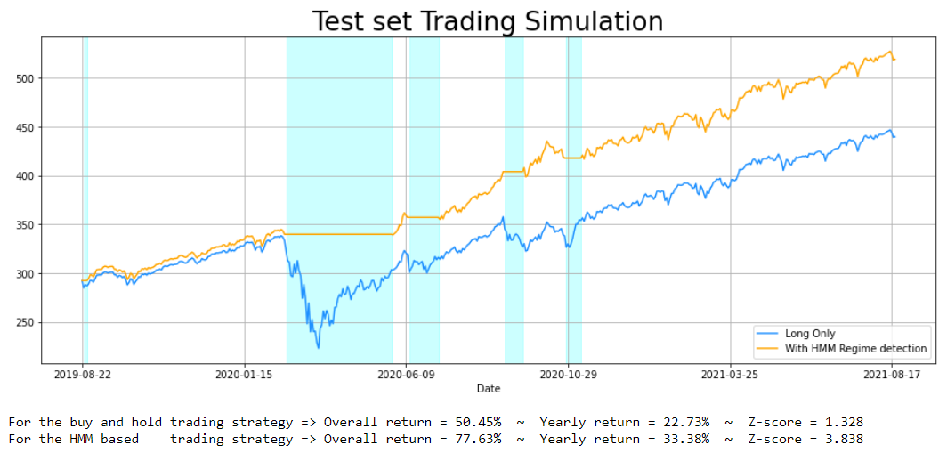
Predictions – Train And Test Sets

Slide 7
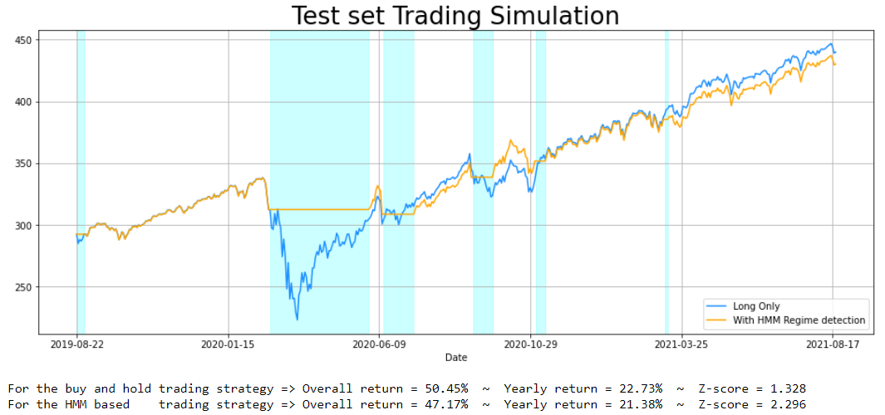

Predictions – Real Predictions …
As the results in last slide looks very promising … We suffered a major data leak.
And after checking the result again we found out the model is not promising at all.

Slide 8
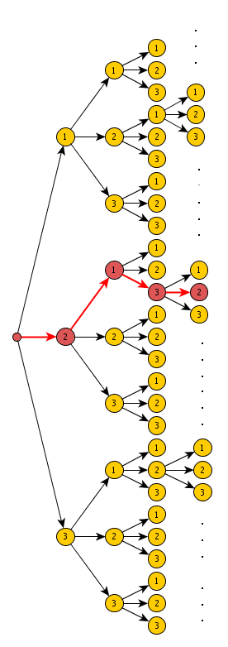
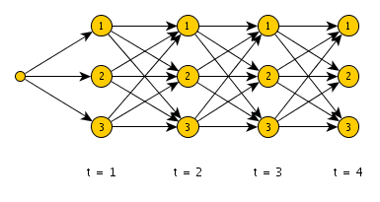
The Viterbi Algorithm
The Viterbi algorithm is a dynamic programming algorithm for obtaining the maximum a posteriori probability estimate of the most likely sequence of hidden states—called the Viterbi path—that results in a sequence of observed events, especially in the context of Markov information sources and hidden Markov models (HMM).

Slide 9
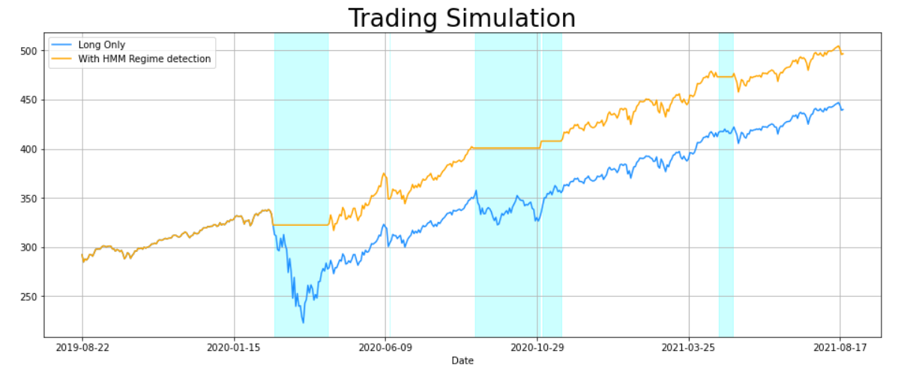
Predictions – Tweaking the model
We Didn’t want to come back empty handed so we tweaked and found different times where the model is acting well and predicting with good performance.

Slide 10
Conclusions
Its hard predicting the stock market.
Always know how to deal with the data.
Check your results before submitting them.
If something is too good to be true – something wend wrong.

